Slide 1


Slide 2






Slide 3




Slide 4


Slide 5


Slide 6
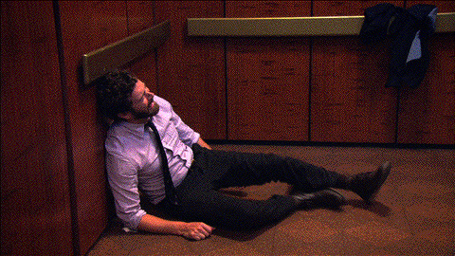

Slide 7
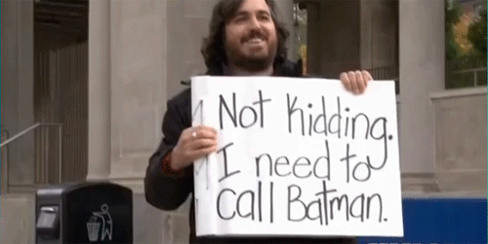

Slide 8


Slide 9


Slide 10


Slide 11


Slide 12


Slide 13


Slide 14


Slide 15


Slide 16


Slide 17


Slide 18


Slide 19


Slide 20


Slide 21
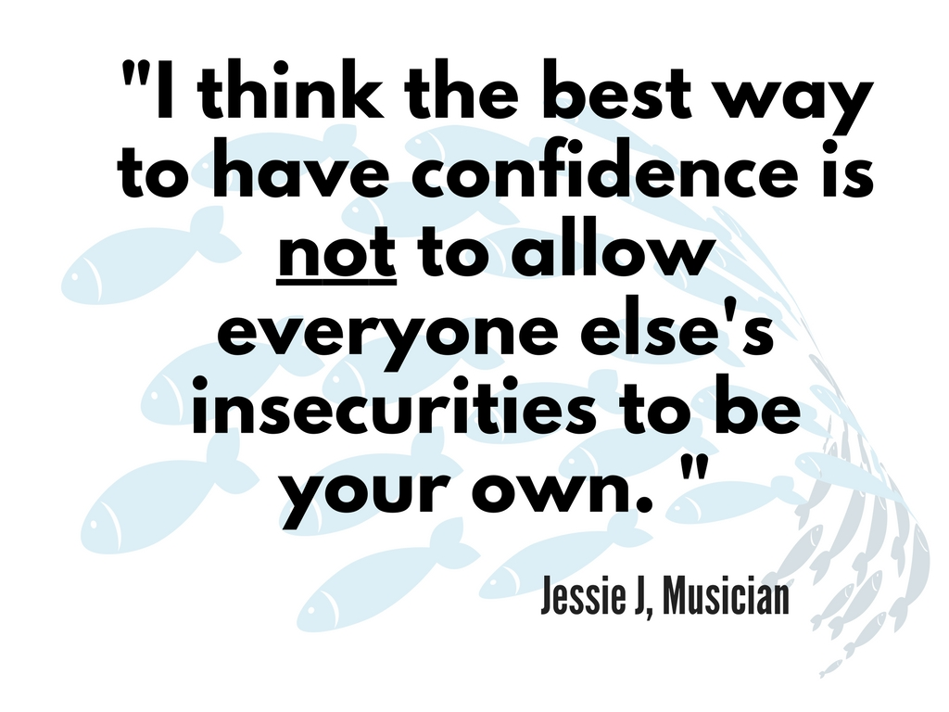

Slide 22


Slide 23


Slide 24


Slide 25


Slide 26


Slide 27


Slide 28


Slide 29


Slide 30

“Do one thing every day that scares you.”
Eleanor Roosevelt, Former First Lady

Slide 31

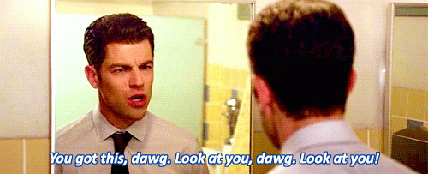
Don’t turn down opportunities to speak.

Slide 32

“Whether you think you can, or you think you can't--you're right.”
Henry Ford, Founder of Ford

Slide 33

Empower yourself!

